Slide 1

Open-source library for space science data analysis and modelling
Jon Niehof (University of New Hampshire)
With
Steve Morley (Los Alamos National Laboratory)
Dan Welling (University of Michigan)

Slide 2

One tool in the box Part of the scientific Python ecosystem
numpy provides high-efficiency array types and operations.
scipy adds many useful scientific, mathematical, and statistical operations.
matplotlib has excellent plotting capabilities, from browse to publication.
SpacePy builds on this base with space science specific functionality.
All are freely available and open source (BSD and GPL compatible)
astropy
spacepy
scipy
matplotlib
pandas
numpy
Python

Slide 3
Intended Audience What is it for?
AutoPlot, SWTK, PaPCo, CDAWeb, ESPAS, …
SPENVIS (Web)
High-level interface
SPEDAS (IDL) & PySPEDAS
SpacePy (Python)
IRBEMlib (FORTRAN)
LanlGeoMag (C)
Plot & data
visualization
tools
B-field
models
& tracing
Other SW
tools
Coordinate
conversion
Time
conversions
Notes:
Data retrieval and plotting tools in top corner – limited analysis.
Separate analysis from visualization and from specific filetypes
Web interfacing good for some uses – not good for operational or intensive use.

Slide 4
Quick summary Scope and philosophy
Open-source
PSF license
Public release 13 years ago
Mid-level
Toolkit/library not application
Magnetosphere, MI coupling, inner heliosphere
Matches developers’ research interests
Development is need-driven:
Science requirements
Data set production
Not just developers’ needs!

Slide 5
Data Model Lightweight; Similar to HDF5
Two basic datatypes:
Group (dict-like)
Dataset (array-like)
Both have metadata
Groups can contain groups or datasets
Datasets are numpy arrays plus metadata
Supports many metadata standards
Global Metadata:
e.g. Filename, code version
Timebase
Variable 1
Local Metadata:
e.g. Units
Variable 2
Local Metadata:
e.g. Units
Variable Group
Group Metadata:
e.g. B-field model
Group Variable 1
Group Variable 2

Slide 6
File Types Conversion via a common data model
HDF5
SWMF
binary
netCDF
MATLAB save
NASA CDF
SpacePy
Data Model
Representation
HTML table
JSON-headed ASCII
DataFrame

Slide 7
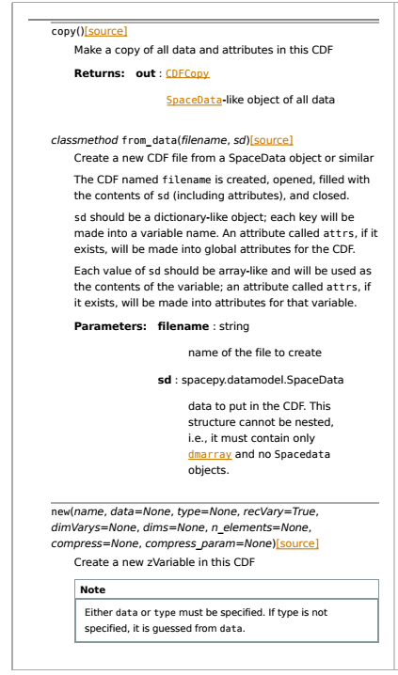
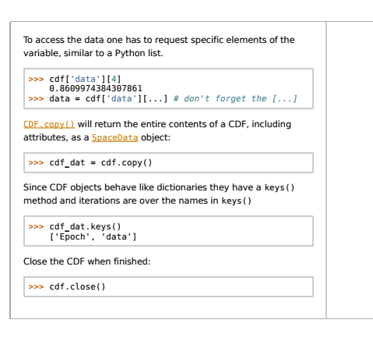
Documentation Quickstart, class ref

Slide 8
Models Included An Incomplete Selection
SpacePy
B-field models from IRBEM library
AE-9/AP-9
Plasmapause
Carpenter & Anderson
Moldwin et al.
O'Brien & Moldwin
Magnetopause standoff
L* neural network
1-D RB diffusion model
Ensemble Kalman filter
IRBEM
CDip; IGRF; Jenson & Cain; Chen & Schulz
T87s; T87l; T89c; T96; T02; TSK03; TS04
Ostapenko & Maltsev; Alexeev
Olsen-Pfitzer
Static; Dynamic
Mead-Fairfield

Slide 9
Tools Included An Incomplete Selection
Tracing
Field lines; Drift shells
Superposed epoch analysis
1D; 2D
Bootstrap CI
Association analysis
Windowing mean (time based, points based)
Time & Coordinate conversions
Full interface to NASA CDF library
Interface to IRBEM library
Plot "helper" routines
add logo
automated time tick formatting
rebinning
SWMF output analysis and visualization

Slide 10
Examples Notes on notebooks
Preloaded on HelioCloud including data: https://github.com/heliophysicsPy/summer-school-24
For local use: https://github.com/spacepy/examples/
Data in public repos including Zenodo
Markdown format, can read directly but make sure to open as notebook
Covering 2 today, 2 more available (ask questions!)

Slide 11
